Slide 1
Chapter 1
Introduction to Computer Networks

Slide 2
Chapter Objectives
Explain the various LAN topologies
Define the function of a networking protocol
Explain the fundamentals of the Token-Ring network
Describe CSMA/CD for the Ethernet protocol
Describe the structure of the Ethernet packet frame

Slide 3
Chapter Objectives
Define the function of the network interface card
Describe the purpose of the MAC address on a networking device
Discuss how to determine the MAC address for a computer
Discuss the fundamentals of IP addressing

Slide 4
Chapter Objectives
Describe a methodology for assembling an office LAN
Describe the steps for assigning an IP address to a computer
Discuss the procedures for troubleshooting a LAN

Slide 5
Network Topologies

Slide 6
Protocol and Topology
Local area networks are defined in terms of the protocol and the topology used for accessing the network.
The networking protocol is the set of rules established for the users to gain control of the network to exchange information.
The topology is the network architecture used to interconnect the networking equipment.

Slide 7
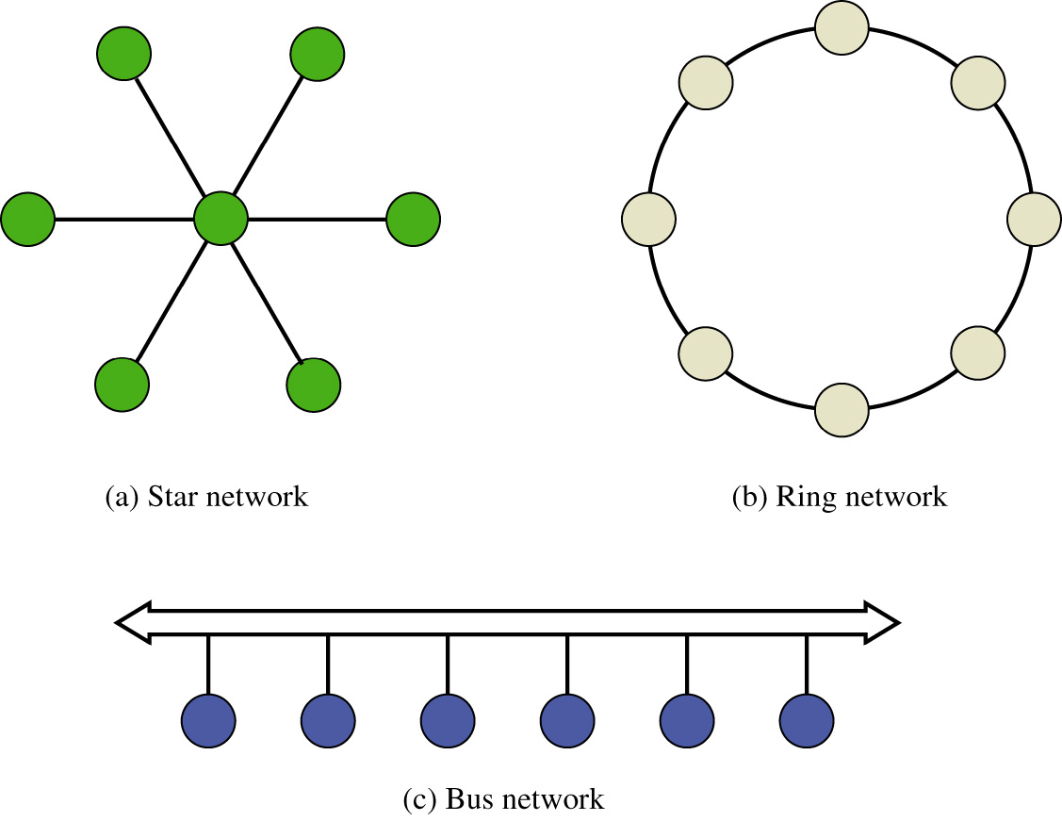
Common Network Topologies

Slide 8
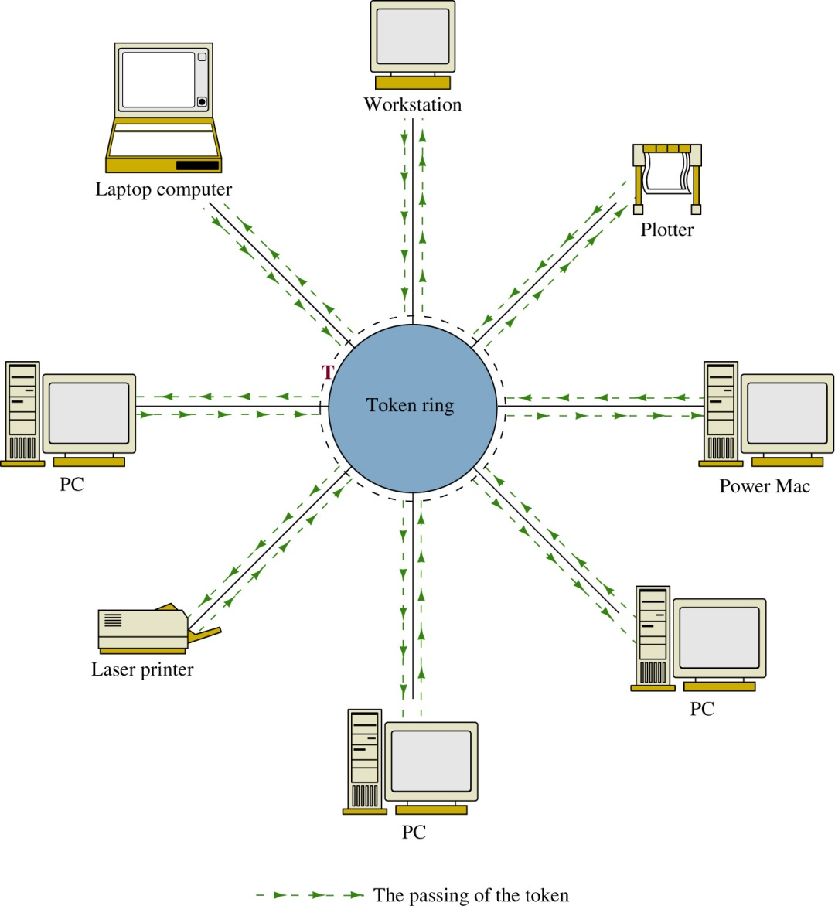
Token-Ring

Slide 9
Token-Ring (IEEE 802.3)
Features:
Token Passing
Advantage:
Deterministic – meaning that the networking devices gain control of the network at fixed time intervals.

Slide 10
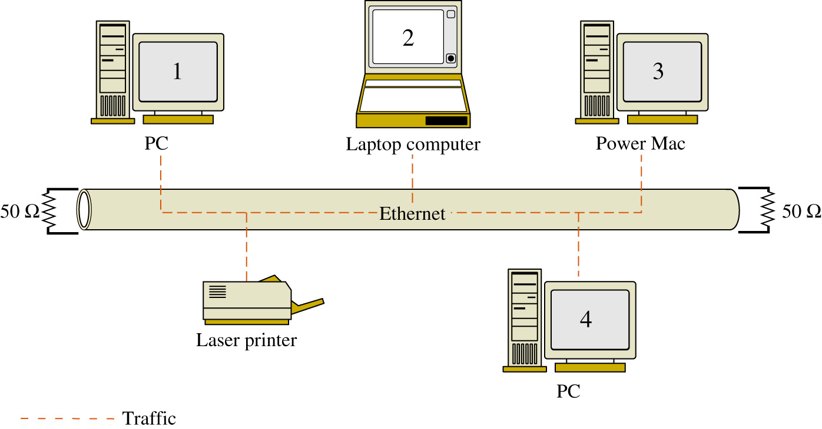
Bus Topology

Slide 11
Bus Topology
Features - network data traffic is carried over a common data link

Slide 12
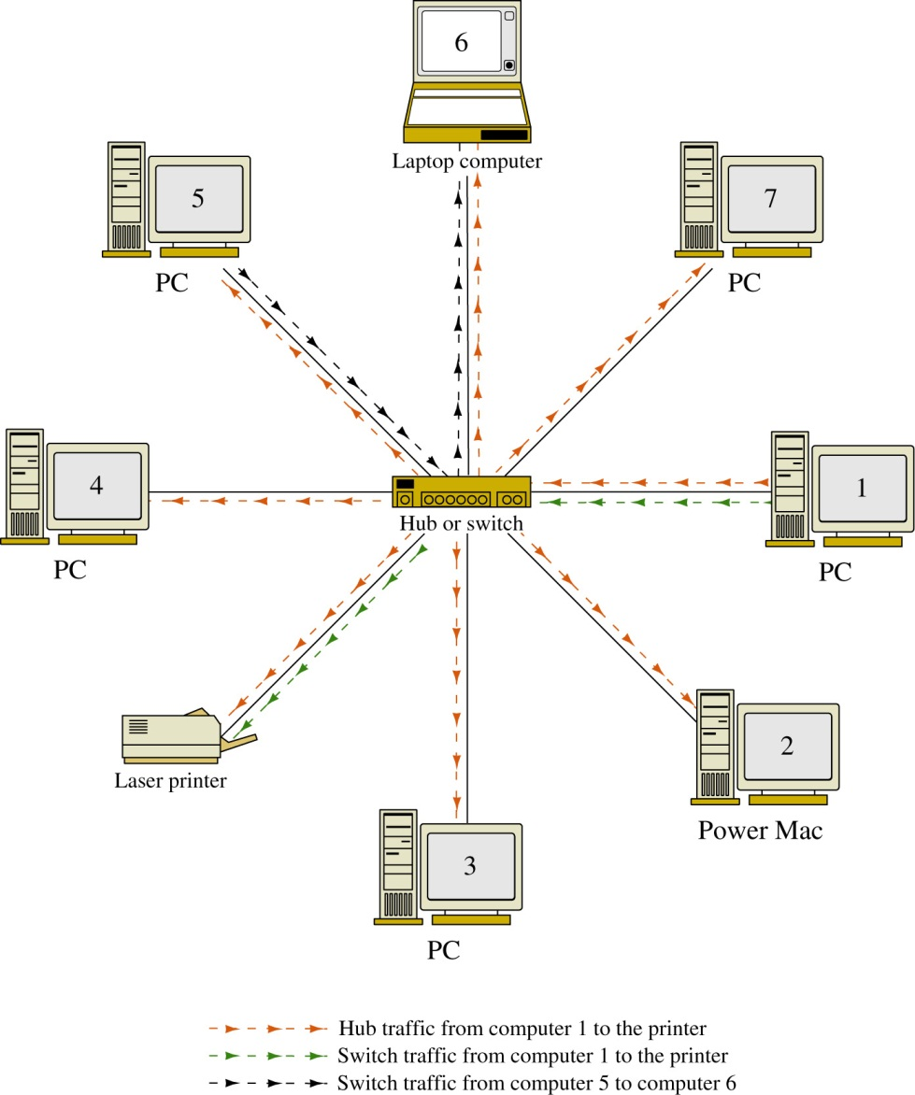
Star Topology

Slide 13
Star Topology
Computers

Slide 14
Star Topology
Computers
Switch (or Hub)
Multiport Repeater

Slide 15
Star Topology
Computers
Switch (or Hub)
Multi-port Repeater
Twisted Pair Cable

Slide 16
Star Topology
Features:
All networking devices connect to a central hub or switch.
The networking devices do not share data connections to/from the central hub or switch
A hub broadcasts all data traffic to all networking devices connected to its data ports.

Slide 17
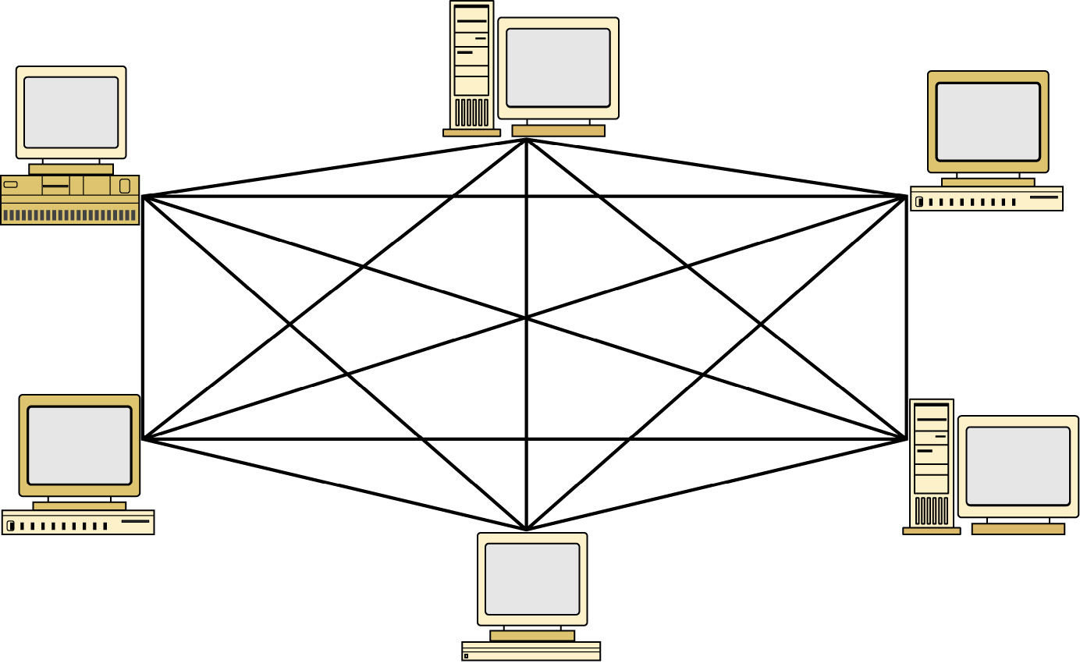
Mesh Topology

Slide 18

Mesh Topology
Features:
All networking devices are heavily interconnected
Redundant data traffic paths
Expensive

